Slide 1

Fibonacci & Art
Classroom Presentation

Slide 2
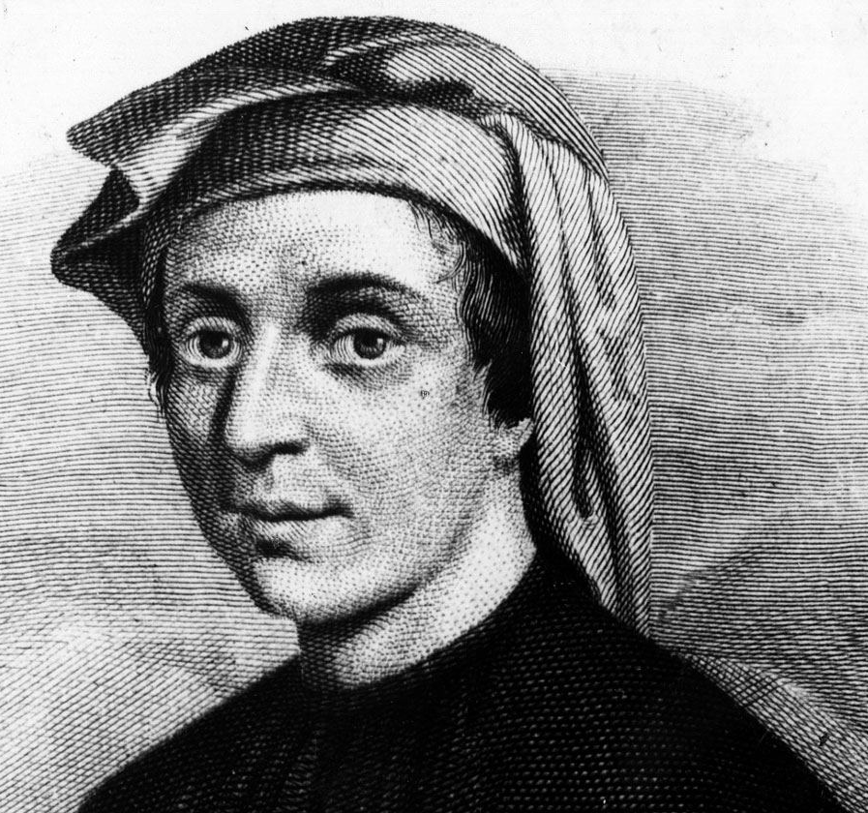
Ciao!*
My name is
Leonardo
Fibonacci, and I am a
mathematician.
(b. 1170- d. 1250)
* Ciao is hello in Italian. Pronounce it like “CHOW.”

Slide 3
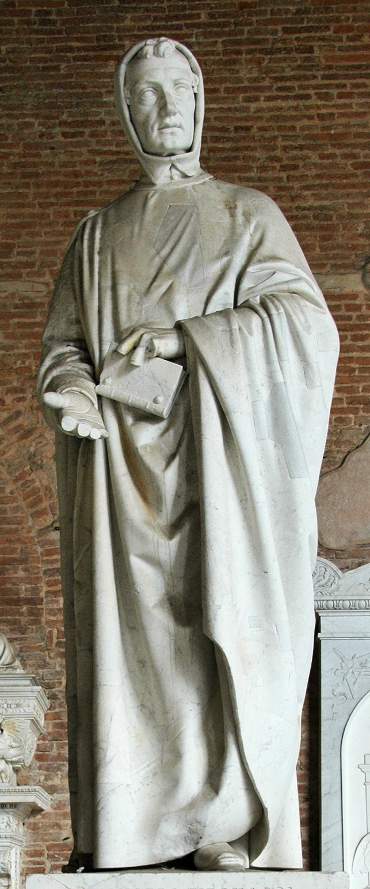
Thanks to Fibonacci,
you’re doing math like this:
3678
– 679
2999
Instead of math like this:
MMMDCLXXVIII
- DCLXXIX
MMCMXCIX
If you’re really good in math, they might make a statue of you!
Grazie, Fibonacci!*
(*Grazie= Thank you in Italian. Pronounce it “grah-tsee”)

Slide 4
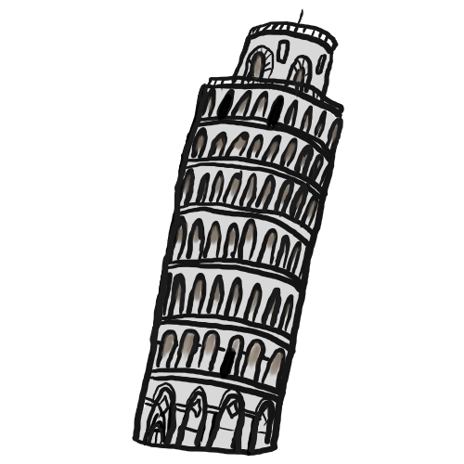
Fibonacci was born in Pisa, Italy in 1170.
He is considered one of
the most famous mathematicians of the
Middle Ages.
When he was working with math problems, he came up with a sequence of numbers:
0, 1, 1, 2, 3, 5, 8, 13, 21, 34, 55, 89, 144 ….
What do you think the rule for the sequence is?

Slide 5
Look carefully at the Fibonacci Sequence’s numbers:
0, 1, 1, 2, 3, 5, 8, 13, 21, ….
Add the first two numbers. What do you get? 0 +1 = 1
Add the second and third numbers? What do you get? 1+1=2
Add the third and fourth numbers? What do you get? 1+2=3
The next number is found by adding the two numbers before it.
What’s the next number in the sequence? (It’s 34.)
Well, why do we care?

Slide 6
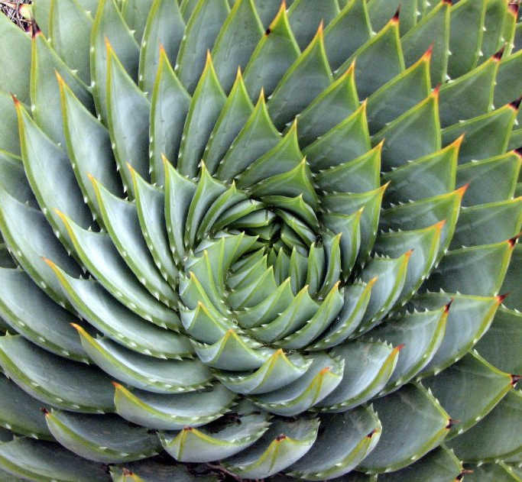
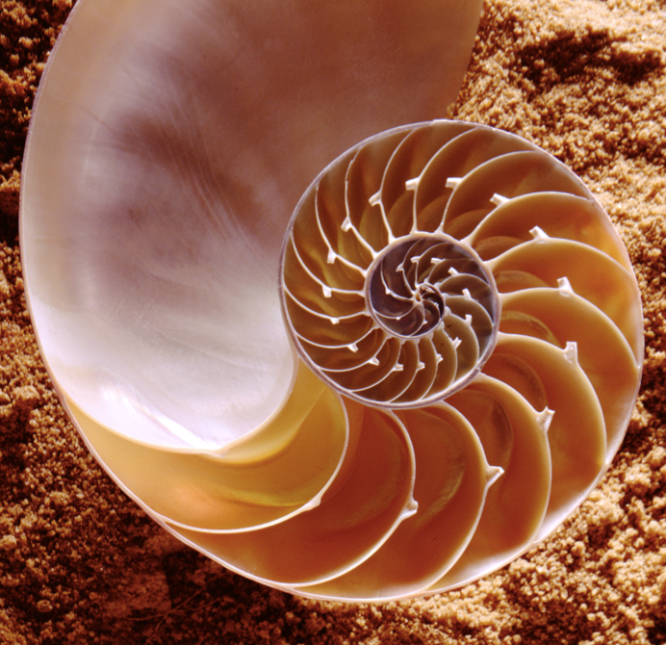
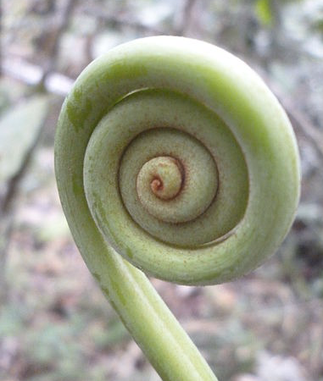
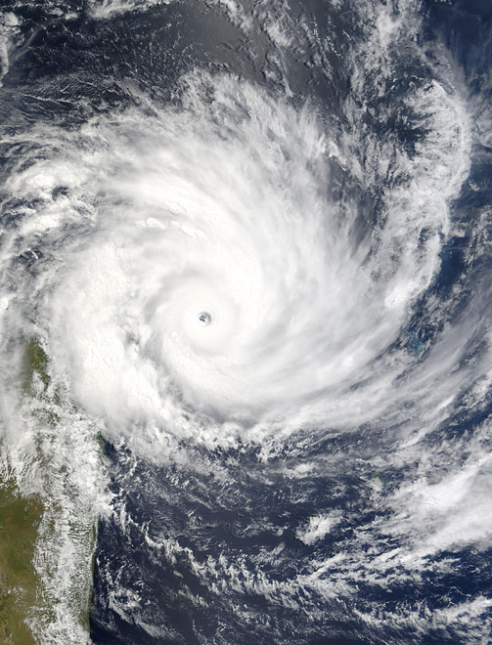
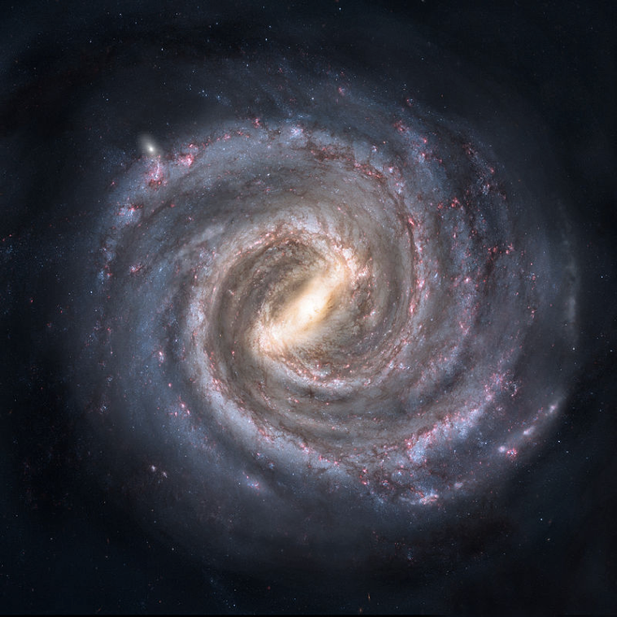
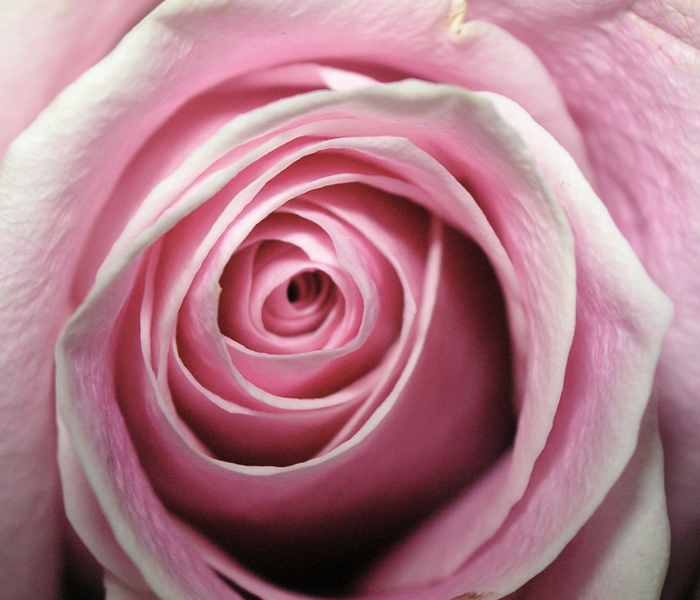
What do these images have in common? How do you think it relates to Fibonacci’s sequence?
Notes:
https://upload.wikimedia.org/wikipedia/commons/9/9e/AmmoniteFossil.JPG
Nautilus Shell/Tracey Nicholls/Wikicommons/https://commons.wikimedia.org/wiki/File:CSIRO_ScienceImage_2933_Nautilus_shell.jpg

Slide 7
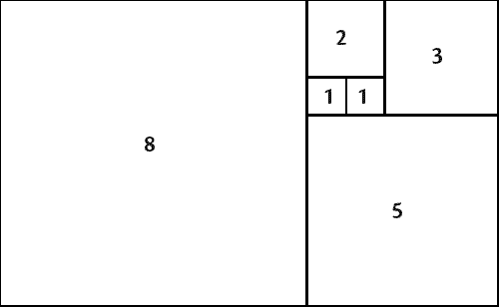
Let’s look at Fibonacci’s sequence and apply it to geometry.
Start with a square. Call it #1. The square is 1 x 1.
Add one next to it. This square will be 1 x 1, too.
Add a third square whole side length is the addition of the first two square. It is 2 x 2.
Keep going. What do you notice about the sequence of squares.
It’s the Fibonacci Sequence!

Slide 8
Now, start at square #1 and draw an arc from one corner to the next.
Continue into the next squares….
What will happen as you keep drawing these arcs?

Slide 9
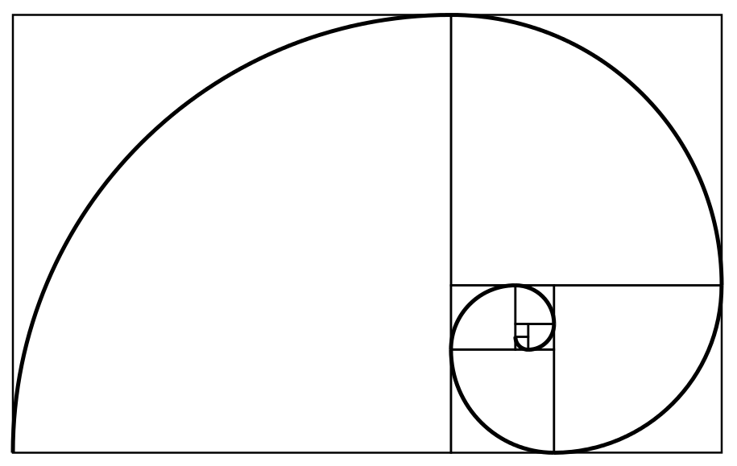
Notes:
https://commons.wikimedia.org/wiki/Spiral#/media/File:Fibonacci_spiral_34.svg

Slide 10
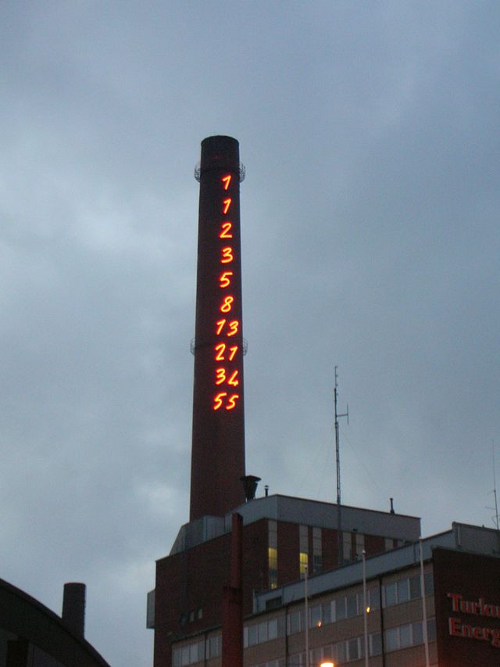
What do you notice in this photograph?
Artist Mario Merz created this neon sculpture on the chimney of a power plant. Do you notice a pattern? What are the next numbers in the sequence?
Why create art for public spaces?
For Merz, the Fibonacci sequence suggests infinity – why do you think he would put it on a power plant’s chimney?
Notes:
Chimney or Turku Energia, Turku, Finland featuring Fibonacci sequence in 2 m high neon lights. Mario Merz/environmental art project 1994

Slide 11
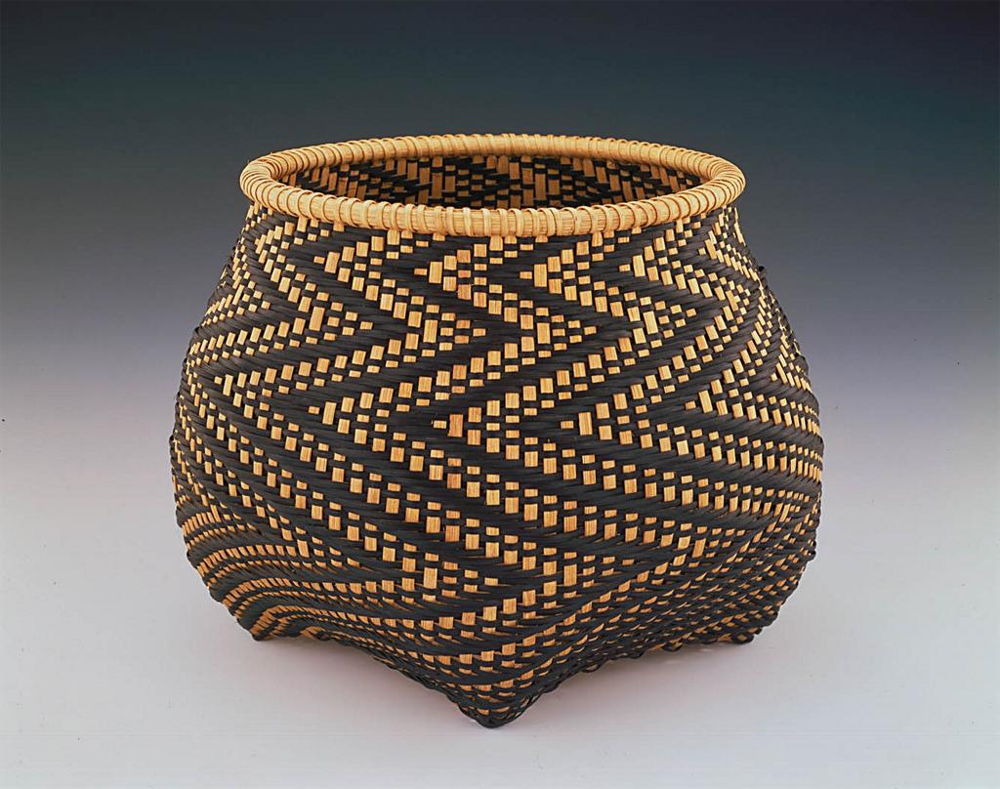
Describe Sudduth’s artwork.
She has incorporated the Fibonacci Sequence. What kind of pattern has it created?
How do you see the Fibonacci Sequence incorporated here?
Notes:
Fibonacci 5
Billie Ruth Sudduth (b. 1945)
1996
Hand-shaped and hand-dyed reed splints with twill weave construction
13 x 16 ½ inches diameter
Smithsonian American Art Museum

Slide 12
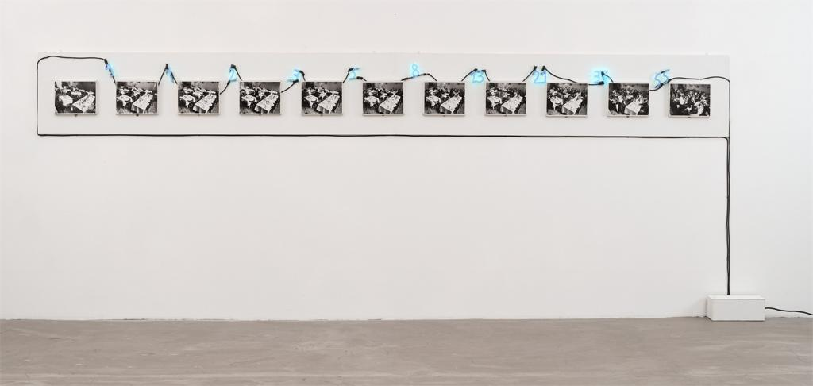
Notes:
Untitled (A Real Sum is a Sum of People)
Mario Merz (1925-2003)
Material: Gelatin silver prints, neon tubing, transformer, wire
MOMA

Slide 13
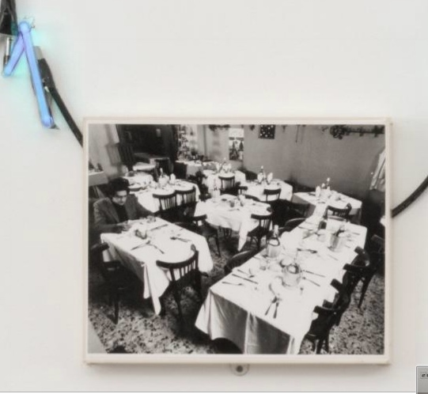
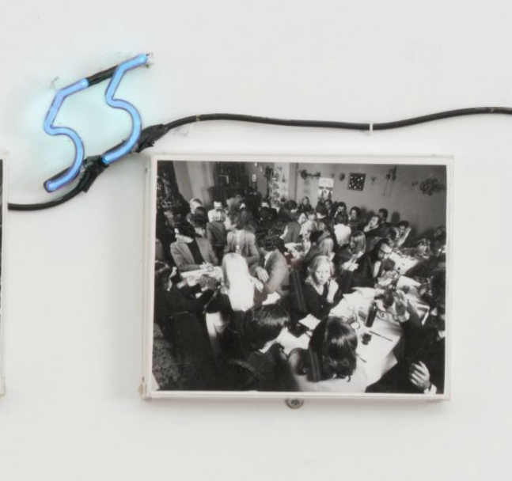
Notes:
Untitled (A Real Sum is a Sum of People)
Mario Merz (1925-2003)
Material: Gelatin silver prints, neon tubing, transformer, wire
MOMA

Slide 14
A short video on spirals and the Fibonacci Sequence
Doodling in Math: Spirals, Fibonacci,
and Being a Plant [1/3]
https://www.khanacademy.org/math/recreational-math/vi-hart/spirals-fibonacci/v/doodling-in-math-spirals-fibonacci-and-being-a-plant-1-of-3
(Running time 5:54)

Slide 15
A short video on spirals and the Fibonacci Sequence
Doodling in Math: Spirals, Fibonacci,
and Being a Plant [1/3]
https://www.khanacademy.org/math/recreational-math/vi-hart/spirals-fibonacci/v/doodling-in-math-spirals-fibonacci-and-being-a-plant-1-of-3
(Running time 5:54)

Slide 16
Extension Activities
Create Fibonacci-inspired artwork:
  Draw a series of Fibonacci-inspires scenes like Merz’s A Real Sum is a Sum of People. Choose a different setting and subjects.
  Use the Fibonacci sequence to create a design like Sudduth’s Fibonacci 5.
  Find a pine cone and count the spirals in different directions. Paint/decorate it.

