Slide 1
Reflecting Life in Art
Classroom Presentation

Slide 2
Pre-Viewing Discussion
When we talk about “reflecting life”, what do we mean?
What are some of the things in life we reflect upon?
Have you ever had a life experience that changed the way you look and think about life? How did it feel to experience that?

Slide 3
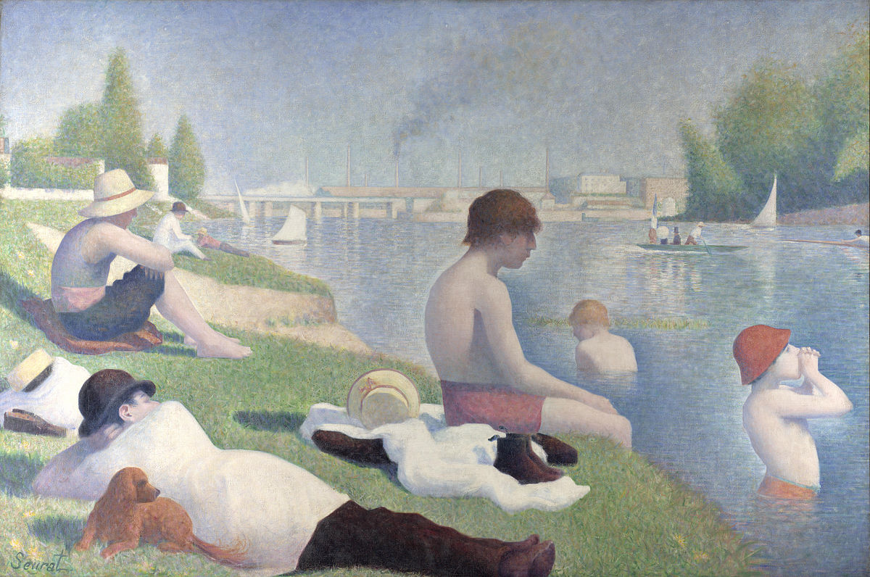
Notes:
What’s happening in this picture?
How does the artist show give a feeling of an moment in life?
Why do you think the artist decided to paint this scene?
What feeling does this scene make you think of? Why?

Slide 4
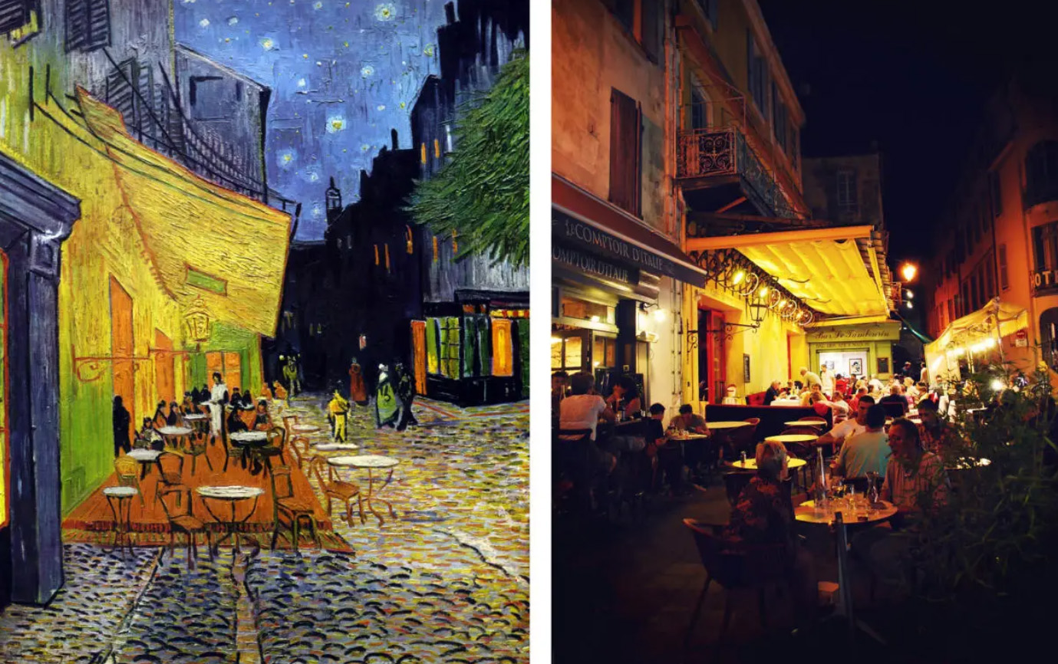
Notes:
What differences do you notice in the painting versus the photo?
Why do you think Van Gogh decided to paint this scene?
If you were at the Café Terrace at Night what you would feel, hear, see?
What else do you notice?

Slide 5
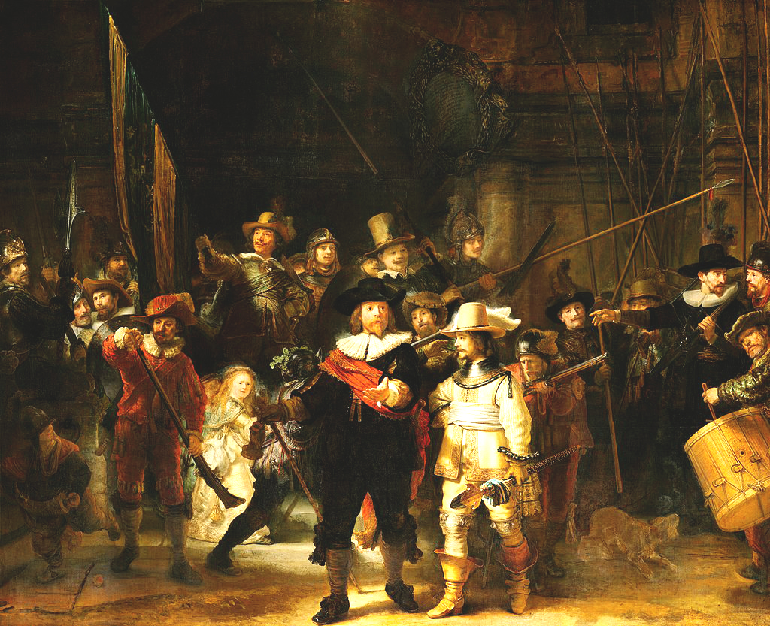
Notes:
What’s going on in the painting?
What can you tell by the way the people are dressed?
Does this painting seem to be telling a story? If so what do you think its about?
What do you think will happen next?

Slide 6
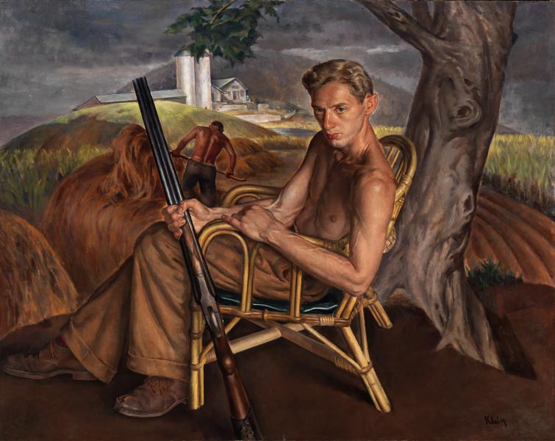
Notes:
What do you notice in the picture?
What do you think the Artist’s motivation was for painting this scene?
What story does this image tell?
What can you tell about the man out from the painting?

Slide 7
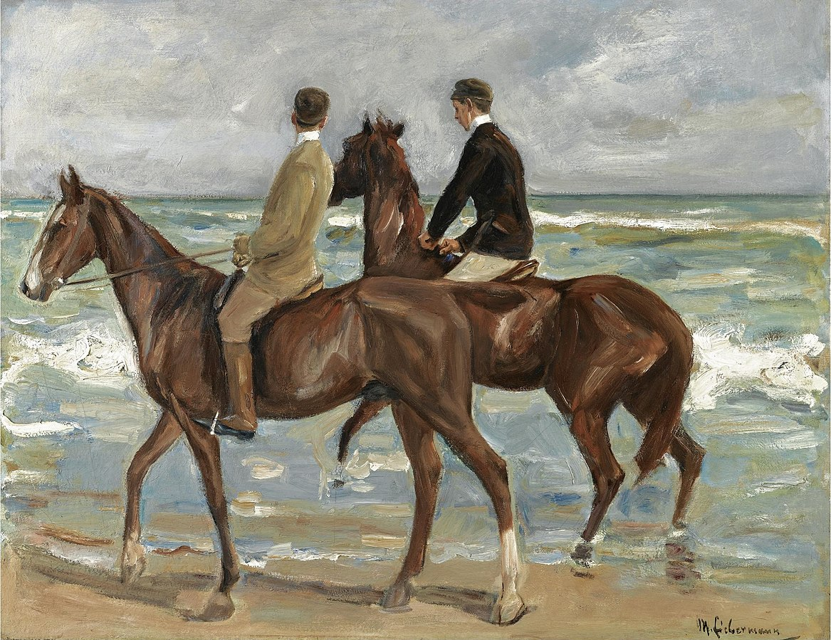
Notes:
What do you notice in this painting?
What idea or feeling might this painting be reflecting?
How do images from moments in time help people?
Have you ever created art from a time you remember in your life?

Slide 8
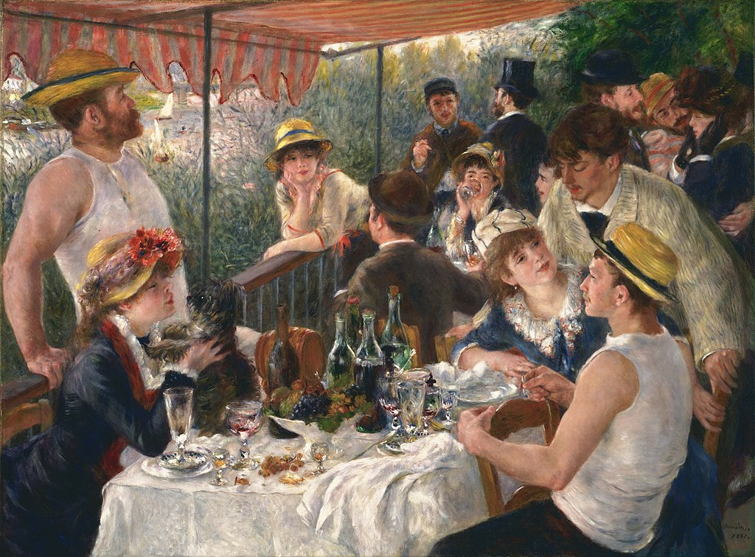
Notes:
What’s going on in this picture?
Why do you this the artist painted this scene?
What do you notice about the style of this painting?
‘Impressionism’ was a style of art that captured an impression of a moment in time. Why do you think artists wanted to do this to do?

Slide 9
Activities
Imagine a time or event you have a fond memory of, and make a drawing of that memory.
Write a poem about something you reflect on in life.
Make a watercolor painting of Your favorite place. Choose colors that convey a feeling.
Write and Describe in as much detail as possible a vivid memory, and why it’s significant.

